Slide 1
Modelling: Answering a question
Modelling
= problem solving under constraints (time, information, understanding, etc.)
Model
= purposeful simplified representation of a real system
These slides mainly from Dr. Volker Grimm
Starfield & Bleloch 1991. Building Models for Conservation and Wildlife.

Slide 2
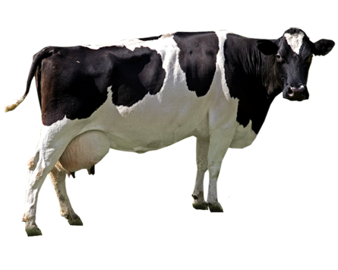
IS IT POSSIBLE TO MODEL A COW?
No, if you try to represent „the cow“
Yes, if you try to represent the cow well enough to answer a certain question
http://pngimg.com/download/2129

Slide 3
SIMPLIFIED REPRESENTATION
Based on data, expert knowledge, and theory, the modeller selects:
The kind of entities to represent
The variables to characterize the entities
The processes which make the entities change
Key question: are these elements essential for the question addressed?

Slide 4
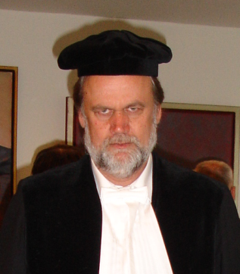
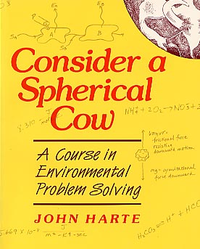
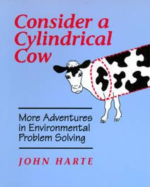
PURPOSE AND SIMPLIFICATION
Reality
Model
http://pngimg.com/download/2129

Slide 5
Modelling: essential or not essential
When trying to solve a problem, or answer a questions, we continuously are asking ourselves the question: is it likely that this aspect of the real system is essential for the solution of my problem?
The problem to be solved serves like a kind of customer, or filter
But how can we know whether something is essential?
Answer: We cannot! That’s why – in science - we develop the model: To see whether we captured key features of the system!!

Slide 6
PURPOSE OF MODELLING
To rigorously explore the consequences of our assumptions, using mathematics and computer logic.

Slide 7
Models address a question
Without a clearly stated question or problem we cannot formulate a simplified representation – we don’t know the purpose of the model
The modelling strategy: “Let us model the system first and later think about the problems we want to answer” DOES NOT WORK
You hear something like: “I want to model the economy of South Korea. Once ready, I will use my model to answer whatever question comes up.”? Run!
Forest model: silviculture, timber extraction, species composition, protection against avalances, forest fires, etc.

Slide 8
Example: checkout queue in the supermarket
Your purpose: minimize your own waiting time
Manager’s purpose: minimize waiting time of all customers (in total/on average)
Managers solution: one single checkout queue for all customers (airports, banks)

Slide 9
How complex should a process be? Example: reproduction
Simplest representation: (you have done this already)
What could we add?
Constraints (age, energy)
Delay (pregnancy)
Interactions (find a mate)
What should we add?
Start simple
Depends on question.
Depends on patterns of the biological system you are trying to reproduce

Slide 10
What is the question?
Are we asking a statistical question? (How many deer should we hunt each season?)
May not need to know detailed mechanism of reproduction
But… if the population in the model is not representing reality well, may need to include more detail
Are we asking a behavioral question? (How should we intervene to ensure strongest deer survive?)
Breeding season – important to leave alone
Shooting at random will not bring down weakest deer

Slide 11
When to use Agent-based models (ABM)
Individual is unique, has variability, different experiences, different current states
Local interactions are important
Individual has adaptive behavior (changes in response to environment)
Use ABM when any one of these is essential to your model. When all three conditions hold, model is ‘full-fledged’. But for many good ABM models, only 1 or 2 of these conditions are important.

Slide 12
Rabies and foxes in England
In Europe, rabies transmitted mainly by red fox
Control by immunizing foxes
Expensive! What is the best strategy?
Differential equation models (modeling fox population as a whole) suggest ‘belt strategy’ around outbreaks
Vaccinate area around outbreak, not outbreak itself
Need to vaccinate 70% of foxes! This is a lot of time and money.

Slide 13
Some characteristics missed by DiffEQ models
Variation in space as well as time
Outbreaks spread in ‘travelling waves’ – alternating high and low infection rates
Individual behavior
Most foxes – territory stationary
Long-distance migration by young foxes
ABM effectively modeled spread of rabies

Slide 14
What is the question?
Question: Best strategy to contain disease?
Turned out local interactions very important to disease spread
Belt strategy would miss carriers ‘passing through’ on long-distance migration
How complicated would fox reproduction need to be in model? Migration? Behavior?

Slide 15
Lessons for agent-based modelling
ABM requires some techniques (programming, mathematics, statistics)
But “modelling” is independent of this
In a scientific model, we make all our heuristics and simplifying assumptions explicit
And, we use mathematics and computer logic to rigorously explore the consequences of these assmputions

Slide 16
Lessons for agent-based modelling
We need to have a clearly formulated research question
We need to simplify to simplify TO SIMPLIFY
Simplify to the threshold of pain, and beyond – and see how it works!
Modelling is an iterative process: formulating the question, the simplified representation, implementing the model as a program, testing the program, analyzing the model output, throwing everything in the trash can, starting with a modified (question/model/program) etc. etc.
The Modelling Cycle

Slide 17
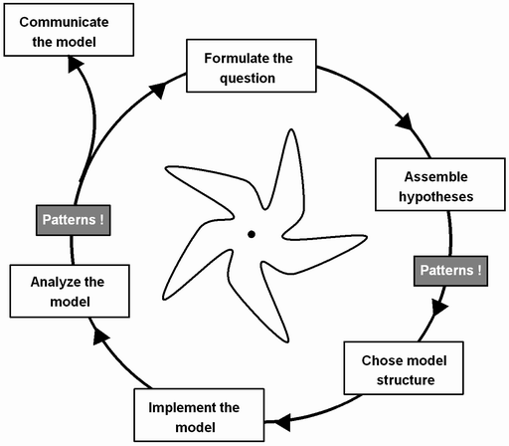
Ze Modeling Cycle

